Slide 1
Board of County Commissioners
Special Meeting
June 10, 2026
Funding EMS
No Action – Keep current service and funding at $1,600,000
EMS MSTU – 3 options/Straw poll on ballot in 2026
Sales Tax – Place on ballot in 2028 and implement in 2029
Use EMS MSTU until Sales Tax referendum
Fund from existing budget/budget cuts
Public Hearing on June 18, 2026, at 5:30 pm

Slide 2
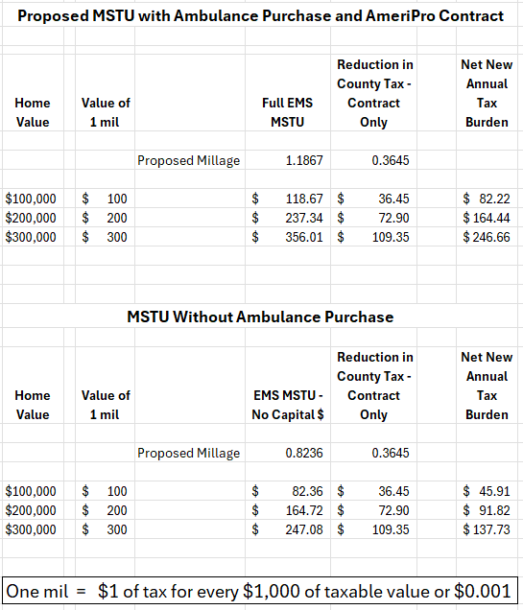
Impact of EMS MSTU
2025 Final Taxable Values
Columbia County: $4,715,155,990
City of Lake City: $1,190,893,248
Town of Fort White: $ 43,601,176
Estimated cost for Ambulance = $800,000
AmeriPro Contract only
EMS MSTU .3645 mil
County Tax Reduction .3645 mil
Net Tax Increase 0 mil

Slide 3
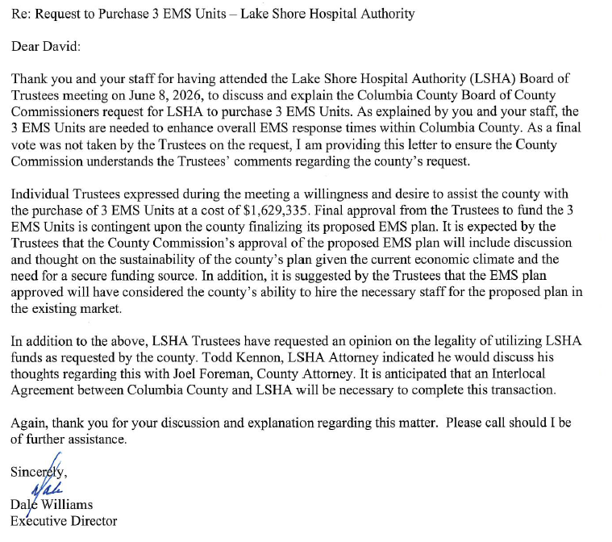
Lake Shore Hospital Authority
LSHA Concerns:
County finalize EMS Plan
Sustainable Funding
Staffing Plan
Interlocal Agreement

Slide 4
Discretionary sales surtaxes:
EMERGENCY FIRE RESCUE SERVICES AND FACILITIES SURTAX.
SECTION 212.055 FS.
(8) EMERGENCY FIRE RESCUE SERVICES AND FACILITIES SURTAX.-
  levy a discretionary sales surtax of up to 1 percent for emergency fire rescue services and facilities as
  the levy of the surtax must be placed on the ballot by the governing authority of the county
  The referendum shall be placed on the ballot of a general election as defined in s. 97.021.
(11) PERFORMANCE AUDIT.-
(a) To adopt a discretionary sales surtax ... an independent certified public accountant licensed pursuant to chapter 473 shall conduct a performance audit of the program associated with the proposed surtax.
(b)1. At least 180 days before the referendum is held, the county... shall provide a copy of the final resolution or ordinance to the Office of Program Policy Analysis and Government Accountability.
2. Within 60 days after receiving the final resolution or ordinance, the Office of Program Policy Analysis and Government Accountability shall procure the certified public accountant and may use carryforward funds to pay for the services of the certified public accountant.
3. At least 60 days before the referendum is held, the performance audit must be completed and the audit report, including any findings, recommendations, or other accompanying documents, must be made available on the official website of the county or school district.

Slide 5
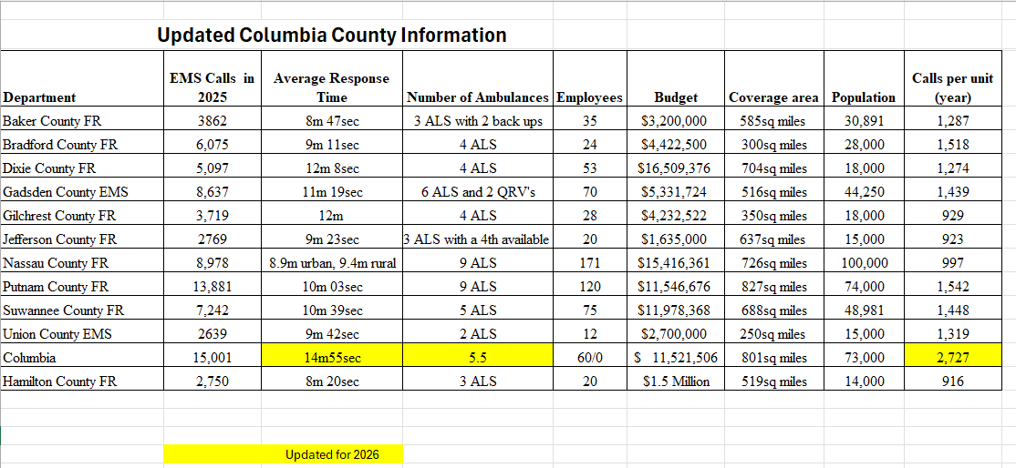
Emergency Medical Services MSTU

Slide 6
Columbia County Fire and Rescue
Adopted Budget:
    County Fire Services (Adopted) $8,595,667
    Fire Coop Agreements (Adopted) $ 24,100
    Community Paramedicine (Adopted Opioid) $1,301,739
    Contract for EMS (FY 2026-27 in General Fund) $1,600,000
    Total $11,521,506
Fire Specific Revenues
    Fire Assessment (Adopted) $7,601,140
    Delinquent/Partial Assessment (Adopted) $ 55,000
    Opioid Settlement Funding (Adopted) $1,301,739
    Public Safety EMS Grant $ 22,629
    Small County Surtax $ 940,998
    General Fund Ad Valorem (FY 2026-27) $1,600,000
    Total $11,521,506
CCFR has 3 ALS Engines
Ft White
Suwannee Valley
Pinemount

Slide 7
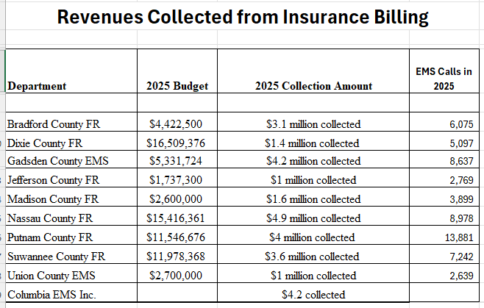
EMS Billing Revenues

Slide 8
EMS FAQ
Columbia County Calls 15,001
Putnam County Calls 13,881
Nassau County Calls 8,972
Calls for service received in 2025:
    Interstate 1,816
    Hotels 3,606
    Truck Stops 554
    Parks 1,681
    Total 7,657
RFP 2024-A
4 responses
American Medical Response $2,155,000.00
RG Ambulance Services(Century) $2,218,147.54

Slide 9
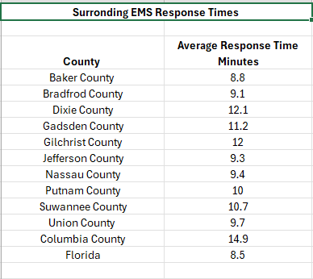
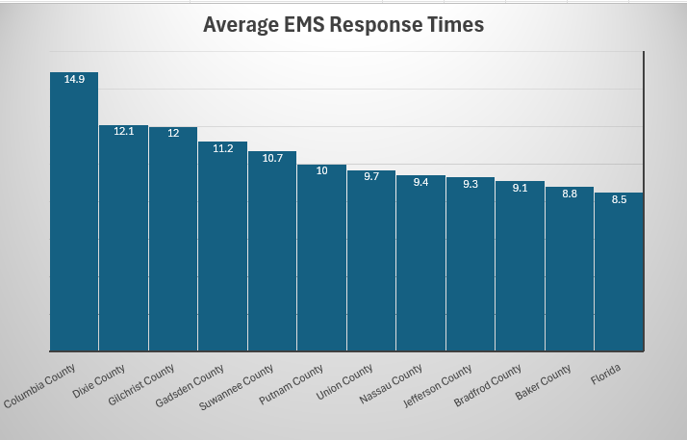
EMS Response Times

Slide 10
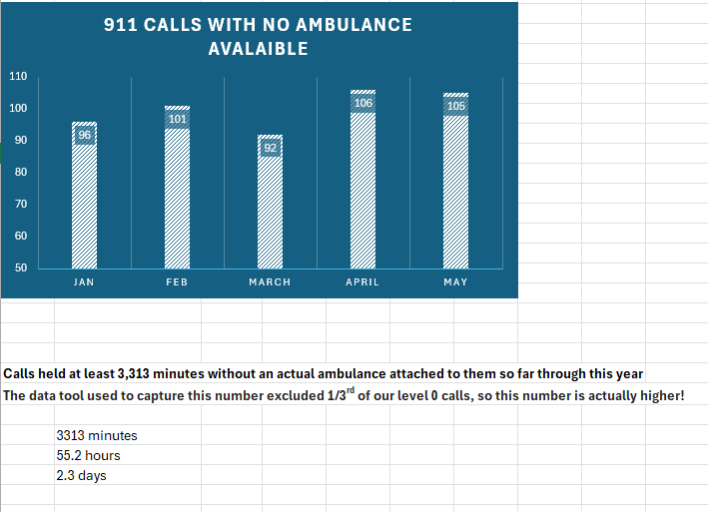
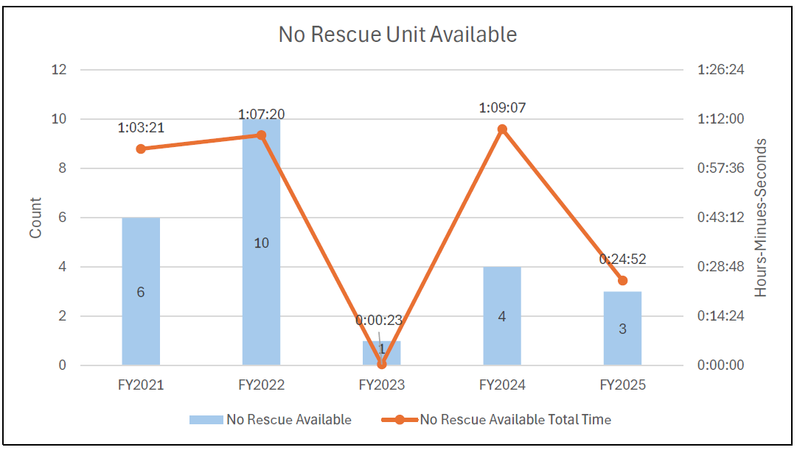
2026 No Ambulance Available by Month
Hold Times in Columbia County
Hold Times in Alachua County
Hold times five months in 2026
3313 Total Minutes
55.2 Hours
2.3 Days
County has had 76.4 minutes of hold time in June 2026

Slide 11
EMS Response Times
In the first 5 months of 2026, the County received 6,197 EMS calls. During this period AmeriPro was not fully staffed.
Longest Response time to a Call:
    Tuesday, February 3rd. Call near Turkey Gln & Drew Feagle Ave. COEM26CAD001342
    Response time: 77 minutes, 22 seconds.
Longest AmeriPro response time:
    Thursday, March 12. Call near Pop Pop Ct & County Road 349. AMER26CAD000406
    Response time: 63 minutes, 48 seconds.
At least 109 calls with a response time greater than 25 minutes for EMS.
At least 80 calls with a response time greater than 30 minutes for EMS.
At least 31 calls with a response time greater than 40 minutes for EMS.

Slide 12
EMD/EFD Dispatch
Not all calls dispatched the same. Calls prioritized by EMD system.
Priority determined by information provided by 911 caller responses to questions
National standardized questions determine priority call levels that dictate response levels
      Alpha or Omega - nonlife-threatening calls = longer required response times
                21 minutes Urban
                26 minutes Rural
      Bravo, Charlie, Delta, or Echo - Life threatening calls = requires quick response times
                11 minutes Urban
                17 minutes Rural

Slide 14
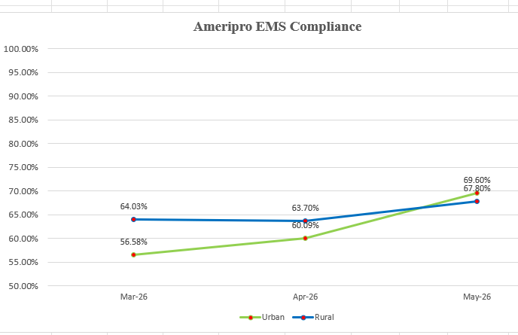
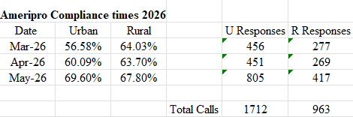
AmeriPro EMS Response Times

